Slide 1
Optimal Football Strategies:
An MDP Approach
Felipe Simon and Elliot Orenstein
IE 8521
Fall 2021

Slide 2
Football is a highly strategic game with a simple objective
Football is a popular team sport played mainly in the U.S.
The main objective of the game is to score more points than the adversary
There are 4 ways of scoring points:
Touchdown (6 points)
Field goal (3 points)
Safety (2 points)
Try after touchdown (1 point for an extra point kick, 2 points for a completed two-point conversion)
In the pursuit of points, the offensive team tries to advance the ball towards the opponent endzone
The offense has 4 opportunities (downs) to advance 10 yards or forfeit possession

Slide 3
What does an optimal play-calling strategy look like?
We focus on a subset of outcomes after four downs and we rank them as follows
+
1st Down
Punt
Turnover on downs
-
We reduce the set of all possible actions to the following three categories:
Pass
Rush
Punt
Goal: When should each action be taken?

Slide 4
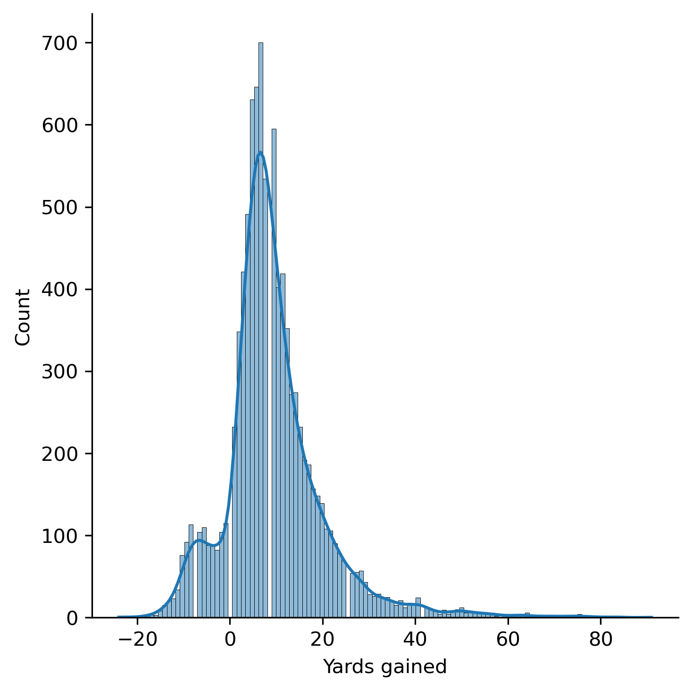
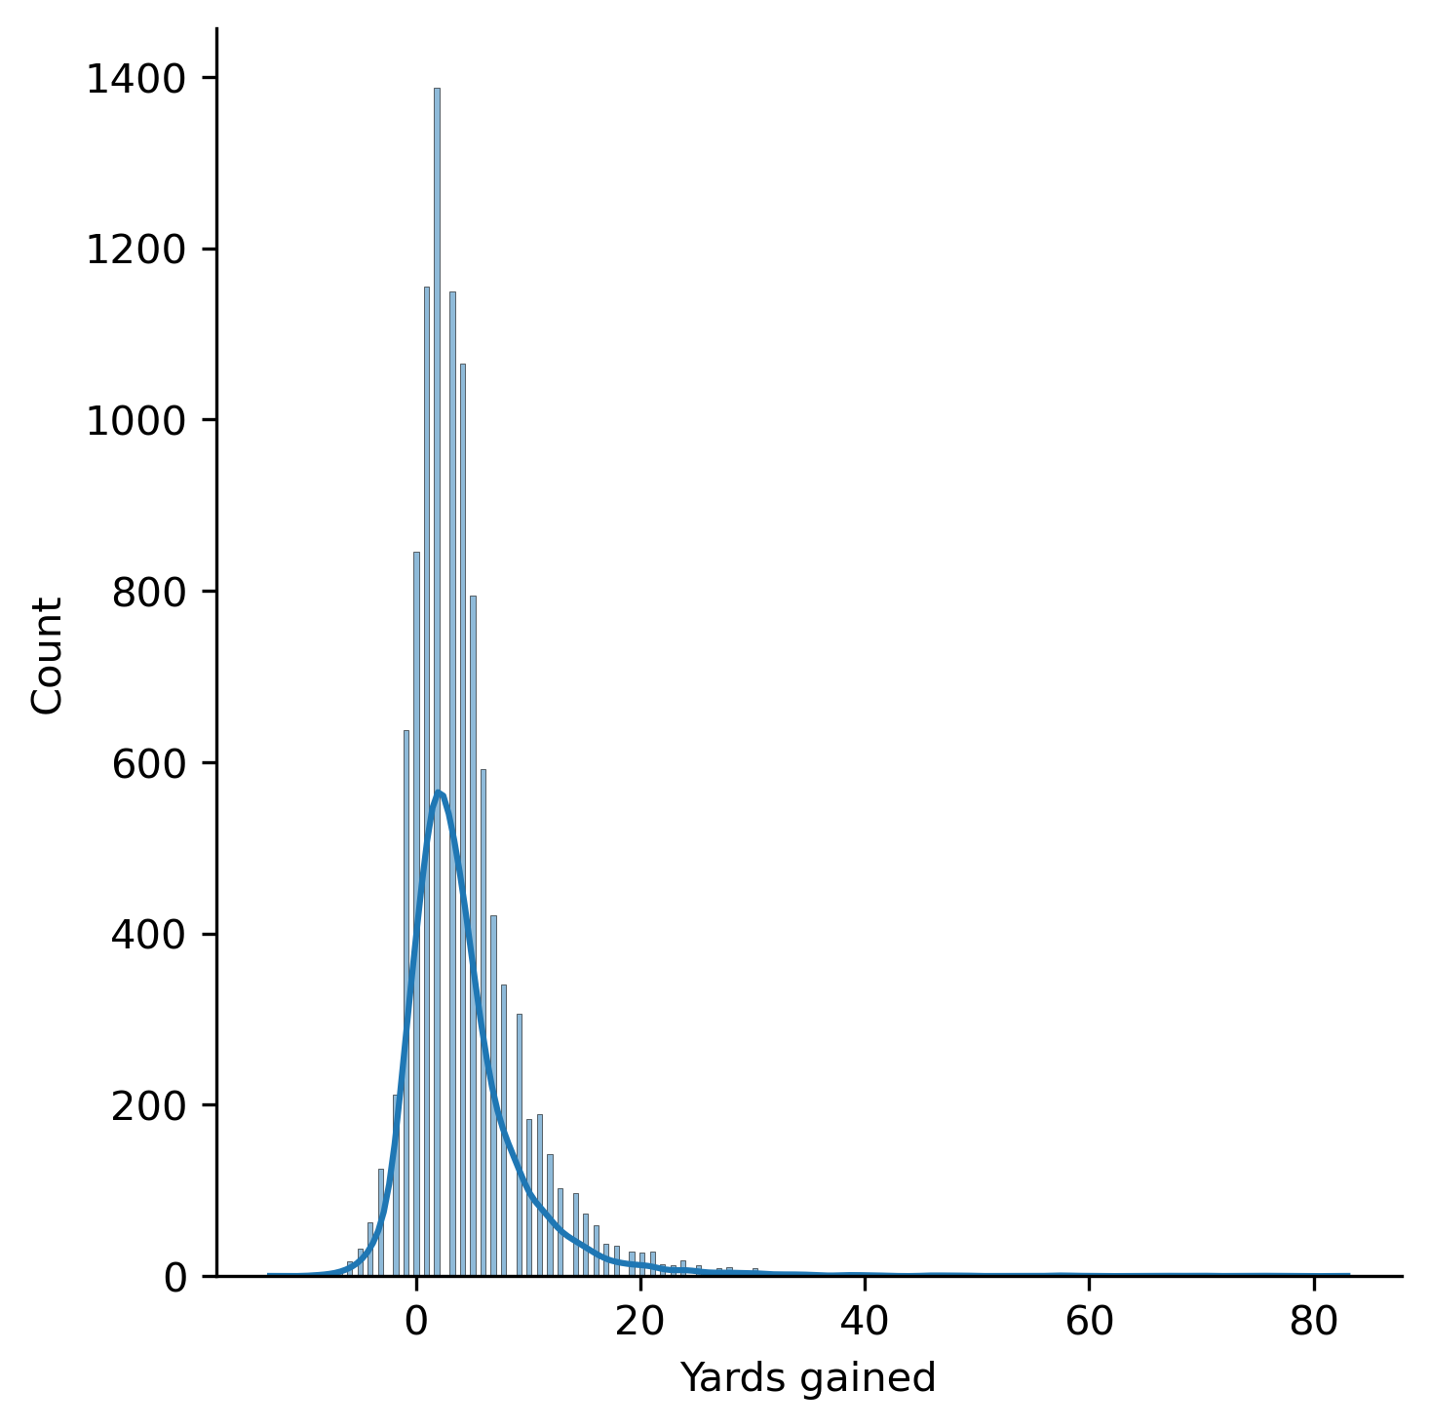
We collected real-world NFL data on passing and rushing plays
Passes*
Rushes
Riskier but can result in more yards
Safer but tend to lead to less yards
*We omit incomplete passes from the plot
Notes:
Other points worth mentioning:
The mode of passes is 10 yards which might be by design
Some rushes can lead to huge benefits (but is rare)

Slide 5
A Markov Decision Process meets the requirements to model our problem
The main challenge for our agent, the coach, is to choose actions in the short term, with uncertain results, that lead to long-term rewards.
A Markov Decision Process is described by:
A set of states S
A set of actions X
Transition probabilities
P_{x}(s, s’) = Pr(s_{t+1}= s’ | s_{t}=s, x_{t}=x)
A reward function R_{x}(s,s’)
P(2 | 8, x)
P(5 | 8, x)
P(2 | 5, x)
8 yards to go
5 yards to go
2 yards to go
P(8 | 5, x)
P(5 | 2, x)
P(8 | 2, x)
MDPs provide a framework for modeling decision-making in situations where outcomes are partly random and partly under the control of the decision maker.

Slide 6

The solution of an MDP can be expressed as the value at each state
The agent’s objective is to maximize their expected, long-run rewards (otherwise known as value V) from each state. The maximum value of each state can be expressed as the maximum, over actions, of the immediate reward taken for the current action plus the discounted expected value of the next state. This is known as the Bellman equation.
Discount factor
Bellman equation
Value at state S_{t}
Action
Rewards depend on action and current state
Expected value of the next state (depends on current state and action)
Solving the Bellman equation yields the value of each state when the optimal action is taken by the agent
Notes:
Bellman equation
What we can obtain by solving the MDP (values and policy)

Slide 7


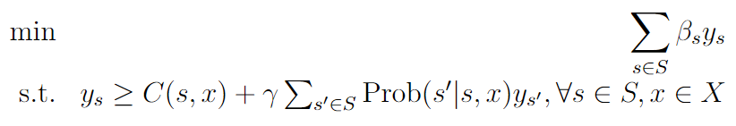
MDPs can be solved via LPs
A maximum problem can be transformed into an LP through the following technique:
Applying this to the Bellman equation, we get the following LP:
where 𝛽_{s} > 0 are arbitrary weights

Slide 8
The optimal values and policy can be determined by the optimal solution of the primal and dual problems
(P)
What we can learn from the primal and dual optimal solutions
Primal
Dual
The primal optimal solution tells us the maximum value attainable for each state in the MDP
The primal constraints corresponding to the non-zero dual variables at optimality are the optimal actions at each state (complementary slackness)
Solving the LP and its dual yields the maximum values of each state as well as the optimal actions for the agent from each state (policy)

Slide 9
Defining States, Actions, Rewards and Transitions for our MDP
A set of states S = S_{y} x S_{d}
S_{y} = {0,1,2,...,20}
S_{d} = {0,1,2,3,4}
A set of actions X = {run, pass, punt}
Transition probabilities P_{x}(s, s’) are determined from the NFL data
In each transition, the downs remaining decreases by one
If the action is punting, the chain will transition to the auxiliary absorbing punting state
The chain has four transitions; all final states will have zero downs remaining
A reward function R_{x}(s,s’)
Rewards are obtained only at the final states (zero rewards for all actions taken from states with positive downs)
1 if the chain ends in the (0,0) state
0 if the chain ends in the auxiliary punting state (if the agent chose to punt at any time)
-1 if the chain ends anywhere else (positive yards remain with zero downs)

Slide 10
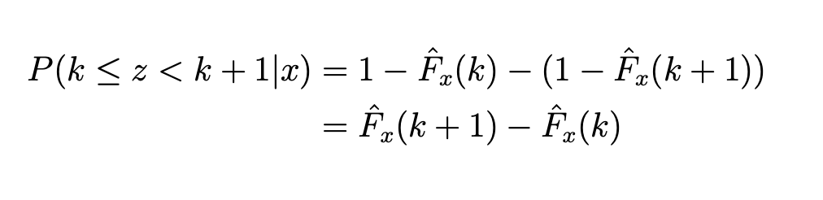
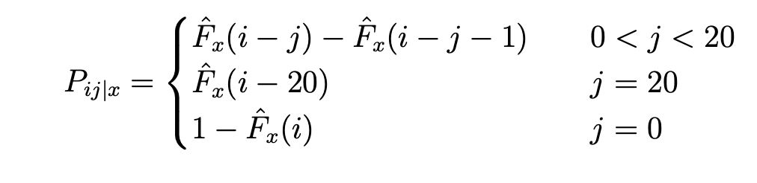
We used the data to calculate the transition probabilities
Passes
Probability of gaining k yards:
F(k)
F(k+1)
Transition probabilities:
P(k < z < k+1)
Notes:
P(k < z < k+1) = 1-F(k) - (1- F(k+1))
= F(k+1) - F(k)

Slide 11
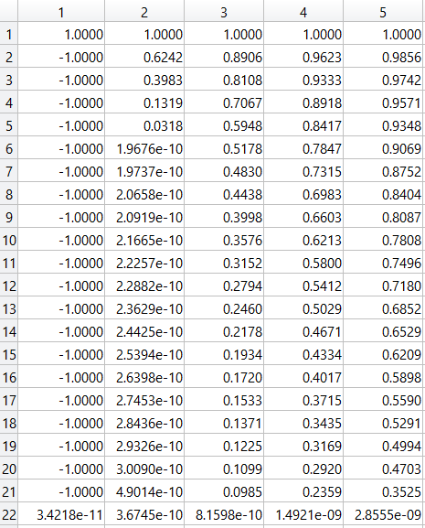
The values from solving the MDP provide insight into football strategies
Key Insights
On fourth down, the value is non-zero from one to four yards remaining and zero for all other yards remaining.
This indicates that the agent can gain more rewards in expectation by using all four downs rather than forfeiting possession via punting.
Downs remaining (+1)
1
Yards remaining (+1)
States across downs and yards can be compared through their values. This can be used when determining whether or not to accept a penalty.
2
Notes:
Table
Fourth down
Comparisons across downs and yards

Slide 12
Recovering the optimal policy from the dual variables
To illustrate how we obtained the optimal policy, let’s look at the dual optimal solution for some states.
Example: 9 dual variable values at optimality
Key Insights
State | Run | Pass | Punt
(7 yards, 3 downs) | 0 | 1.60 | 0
(4 yards, 2 downs) | 2.28 | 0 | 0
(5 yards, 1 down) | 0 | 0 | 2.84
Punting only occurs on fourth down and more than 4 yards to-go
Passing is preferred to running when in a state with fewer downs or more yards remaining
The optimal policy is deterministic → easy to strategize against
Optimal action at given state
Notes:
Tables
Interpretation
Insights: punting only on fourth down, passing when further away

Slide 13
Conclusions
We presented a framework to calculate the optimal policy for getting a first down in football based on historical data.
Optimization plays a key role in our method for finding the value of each state and to recover the optimal policy.
In our simplified scenario, we found that coaches are often too conservative in the fourth down, punting more than they should.
This work has several future next steps, for example we did not study how our model fits real strategies taken by teams during official matches.

Slide 14
References
NFL. NFL rulebook. 2021. url: https://operations.nfl.com/the-rules/nfl-video-
rulebook/scoring-plays/ (visited on 12/10/2021).
Shuzhong Zhang, Dynamic Optimization and Applications, lecture notes, SEG3470
Shuzhong Zhang, F 2021, Linear Programming: The Basics, lecture notes, IE 8521, University of Minnesota - Twin Cities

